Slide 1
Lecture 12
ITEC618
Preparation for Assessment 2
Lecturer: Dr. Farshid Keivanian

Slide 2
Motivations
The sample codes and tasks have been designed in alignment with the programming assignments detailed in the assessment 2, offering a constructive basis for learning how to approach the projects and achieve high-distinction marks. However, these are not direct answers to the tasks but rather serve as similar examples to guide you in learning the required skills and concepts. Each sample addresses key aspects of the tasks in the programming assignment but with variations to ensure they are suitable for educational use without directly solving the assignment tasks. This approach helps you understand how to apply the concepts to solve similar problems independently.
2

Slide 3
Discussion Question
What is a palindrome and how can you check for one in a string?
A palindrome is a word, phrase, number, or other sequences of characters which reads the same backward as forward, such as "madam" or "racecar". You can check for a palindrome by reversing the string and comparing it to the original, ignoring case and spaces.
3

Slide 4
Task: Palindrome Checker
Sample Assignment – Palindrome Checker:
Task: Develop a Java method that checks if a given string is a palindrome.
Requirements:
Method signature: public static boolean isStringPalindrome(String text)
The method returns true if text is a palindrome, ignoring case and spaces.
4

Slide 5
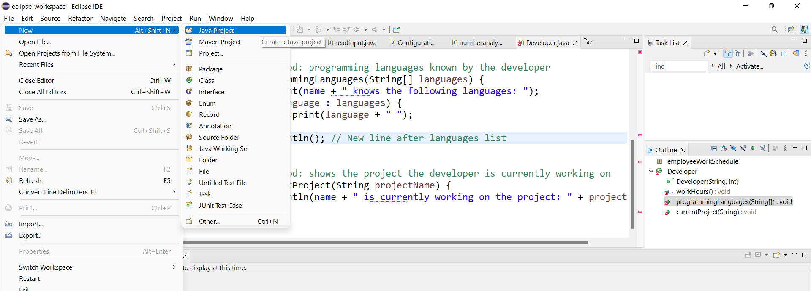
1. Open Eclipse:
Launch Eclipse IDE on your system.
Create a new project by going to File > New > Java Project.
5

Slide 6
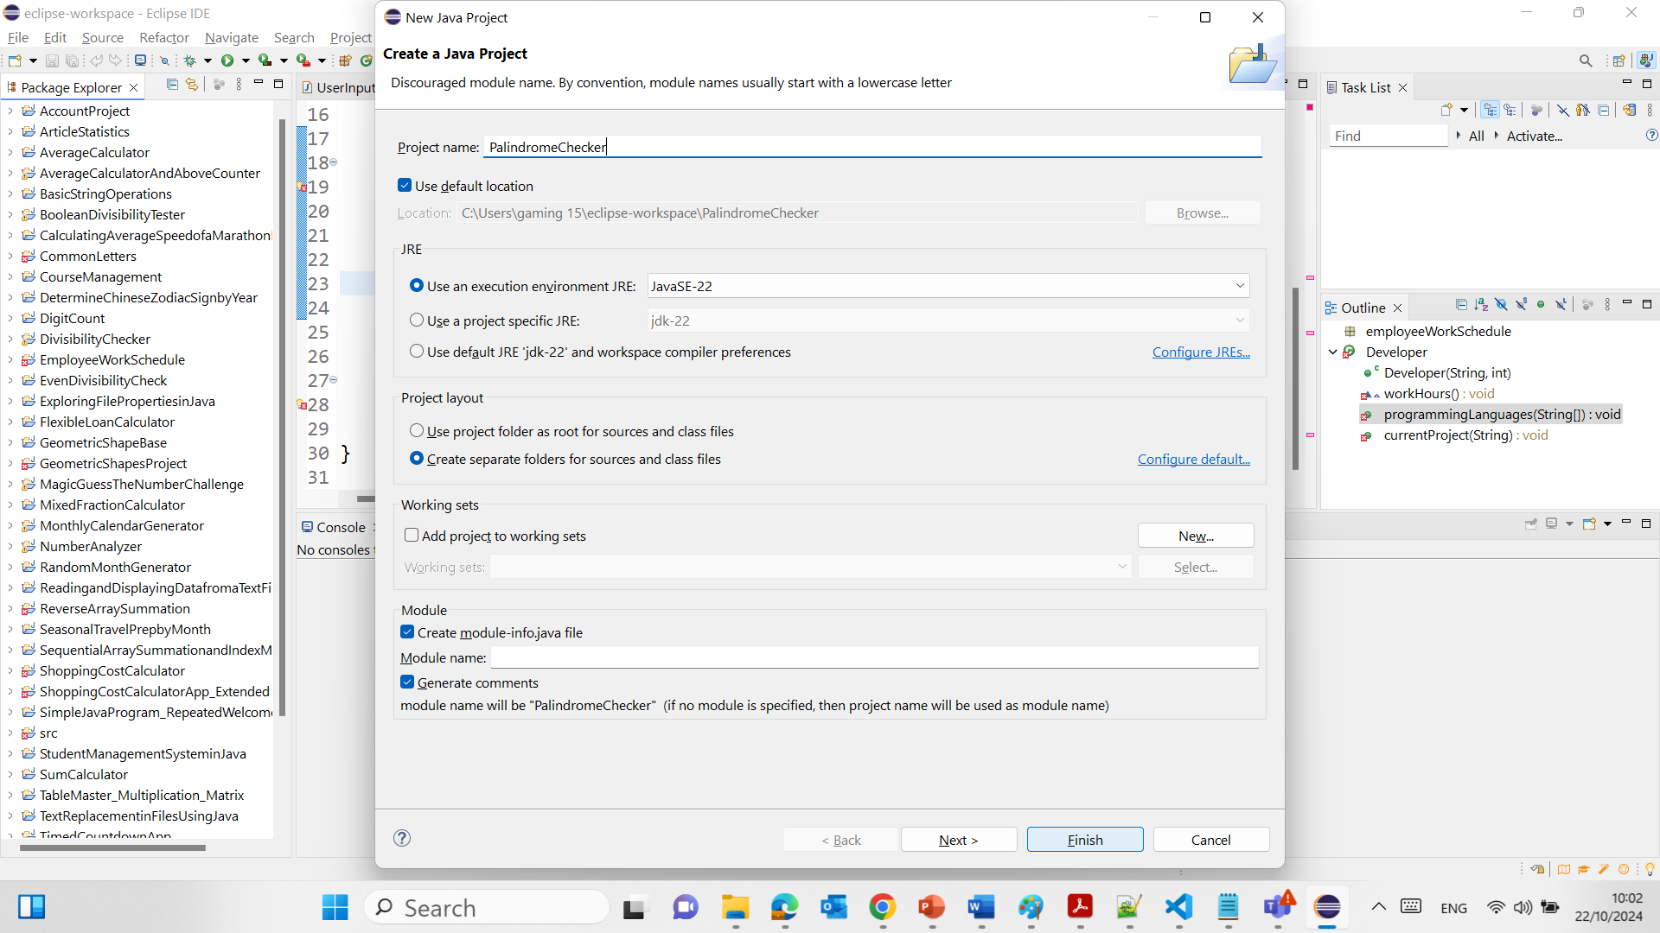
6

Slide 7
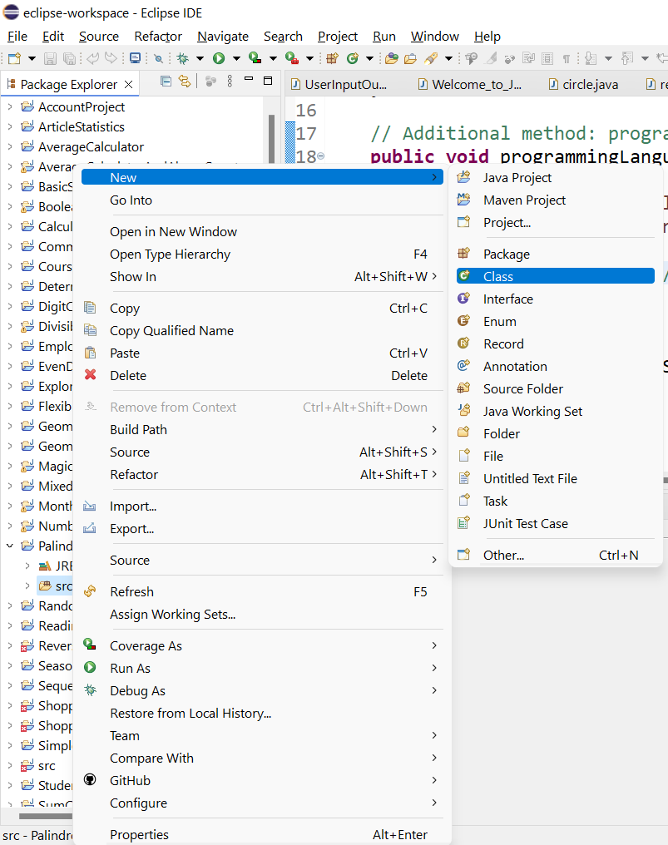
2. Create a New Class:
Right-click on the src folder in your project, and select New > Class.
Name your class something appropriate like PalindromeChecker.
Check the box for public static void main(String[] args) to create the main method automatically.
7

Slide 8
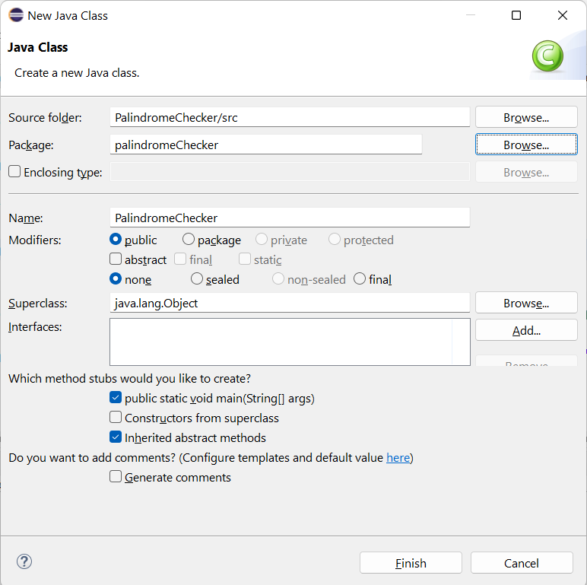
2. Create a New Class:
Right-click on the src folder in your project, and select New > Class.
Name your class something appropriate like PalindromeChecker.
Check the box for public static void main(String[] args) to create the main method automatically.
8

Slide 9
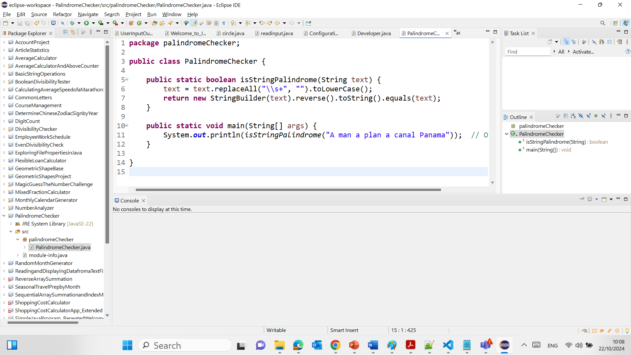
The code checks whether a given string is a palindrome, meaning it reads the same forward and backward (ignoring spaces and case). Here's what it does step by step:
Package Declaration:
The code is part of the palindromeChecker package, which organizes the class into a logical grouping.
Class Declaration:
The class PalindromeChecker contains the logic for checking if a string is a palindrome.
9

Slide 10
Palindrome Checking Method:
The isStringPalindrome method takes a string as input (parameter text), processes it by:
Removing all whitespace (spaces, tabs, newlines).
Converting all letters to lowercase (so the check is case-insensitive).
Then, it reverses the string and compares it with the original (processed) string.
If the reversed string is the same as the original, the method returns true (i.e., the string is a palindrome).
If not, it returns false.
10

Slide 11
Main Method:
In the main method, the program checks whether the string "A man a plan a canal Panama" is a palindrome.
It prints the result (true) because this string, when spaces are removed and converted to lowercase, reads the same backward as forward.
11

Slide 12
Example of how the string is processed:
Input: "A man a plan a canal Panama"
After removing spaces and converting to lowercase: "amanaplanacanalpanama"
Reverse of this string: "amanaplanacanalpanama"
Since both are the same, the method returns true, and this result is printed.
12

Slide 13
3. Implement the isStringPalindrome Method:
Inside the class, implement the given method. This method will take a string, ignore spaces and cases, and check if it is a palindrome.
13

Slide 14
package palindromeChecker;
public class PalindromeChecker {
public static boolean isStringPalindrome(String text) {
text = text.replaceAll("\\s+", "").toLowerCase();
return new StringBuilder(text).reverse().toString().equals(text);
}
public static void main(String[] args) {
System.out.println(isStringPalindrome("A man a plan a canal Panama")); // Output: true
}
}
package palindromeChecker;:
This line defines the package name for this Java class. A package is a way to organize related classes and avoid naming conflicts. Here, palindromeChecker is the package name, which means this class belongs to that package. It helps in better management of large applications.
14

Slide 15
package palindromeChecker;
public class PalindromeChecker {
public static boolean isStringPalindrome(String text) {
text = text.replaceAll("\\s+", "").toLowerCase();
return new StringBuilder(text).reverse().toString().equals(text);
}
public static void main(String[] args) {
System.out.println(isStringPalindrome("A man a plan a canal Panama")); // Output: true
}
}
public class PalindromeChecker {:
This line declares a public class named PalindromeChecker. The keyword public means that this class is accessible from other classes in different packages, while class defines it as a blueprint for creating objects. In this case, the class contains methods related to palindrome checking.
15

Slide 16
package palindromeChecker;
public class PalindromeChecker {
public static boolean isStringPalindrome(String text) {
text = text.replaceAll("\\s+", "").toLowerCase();
return new StringBuilder(text).reverse().toString().equals(text);
}
public static void main(String[] args) {
System.out.println(isStringPalindrome("A man a plan a canal Panama")); // Output: true
}
}
public static boolean isStringPalindrome(String text) {:
This line defines a public method called isStringPalindrome, which is static, meaning it belongs to the class and can be called without creating an object of the class. The method returns a boolean (true or false) and takes a single String parameter called text. It checks if the provided string is a palindrome.
16

Slide 17
package palindromeChecker;
public class PalindromeChecker {
public static boolean isStringPalindrome(String text) {
text = text.replaceAll("\\s+", "").toLowerCase();
return new StringBuilder(text).reverse().toString().equals(text);
}
public static void main(String[] args) {
System.out.println(isStringPalindrome("A man a plan a canal Panama")); // Output: true
}
}
text = text.replaceAll("\\s+", "").toLowerCase();:
This line modifies the input string by:
replaceAll("\\s+", ""): This removes all whitespace characters (spaces, tabs, newlines) from the string. The regular expression \\s+ matches one or more whitespace characters.
toLowerCase(): This converts the string to lowercase, ensuring the palindrome check is case-insensitive. This step ensures that variations in letter case (like 'A' vs 'a') don't affect the result.
17

Slide 18
package palindromeChecker;
public class PalindromeChecker {
public static boolean isStringPalindrome(String text) {
text = text.replaceAll("\\s+", "").toLowerCase();
return new StringBuilder(text).reverse().toString().equals(text);
}
public static void main(String[] args) {
System.out.println(isStringPalindrome("A man a plan a canal Panama")); // Output: true
}
}
return new StringBuilder(text).reverse().toString().equals(text);:
This line performs the palindrome check:
new StringBuilder(text): This creates a StringBuilder object with the modified string (text).
reverse(): This reverses the string.
toString(): Converts the reversed StringBuilder back into a String.
equals(text): This checks if the reversed string is equal to the original (modified) string. If they are equal, it returns true (the string is a palindrome); otherwise, it returns false.
18

Slide 19
package palindromeChecker;
public class PalindromeChecker {
public static boolean isStringPalindrome(String text) {
text = text.replaceAll("\\s+", "").toLowerCase();
return new StringBuilder(text).reverse().toString().equals(text);
}
public static void main(String[] args) {
System.out.println(isStringPalindrome("A man a plan a canal Panama")); // Output: true
}
}
public static void main(String[] args) {:
This line defines the main method, which serves as the entry point for the program. It is static, meaning it can be called without creating an object of the class, and public, meaning it can be accessed from outside the class. The String[] args parameter is used to pass command-line arguments, though they are not used in this example.
19

Slide 20
package palindromeChecker;
public class PalindromeChecker {
public static boolean isStringPalindrome(String text) {
text = text.replaceAll("\\s+", "").toLowerCase();
return new StringBuilder(text).reverse().toString().equals(text);
}
public static void main(String[] args) {
System.out.println(isStringPalindrome("A man a plan a canal Panama")); // Output: true
}
}
System.out.println(isStringPalindrome("A man a plan a canal Panama"));:
This line calls the isStringPalindrome method with the string "A man a plan a canal Panama" as the argument. It checks whether the string is a palindrome and prints the result (true or false) to the console using System.out.println.
20

Slide 21
package palindromeChecker;
public class PalindromeChecker {
public static boolean isStringPalindrome(String text) {
text = text.replaceAll("\\s+", "").toLowerCase();
return new StringBuilder(text).reverse().toString().equals(text);
}
public static void main(String[] args) {
System.out.println(isStringPalindrome("A man a plan a canal Panama")); // Output: true
}
}
}:
These closing braces mark the end of the PalindromeChecker class and the methods inside it.
In summary, the program removes spaces and converts the input string to lowercase, then checks if the string is the same forwards and backwards, printing the result to the console.
21

Slide 22
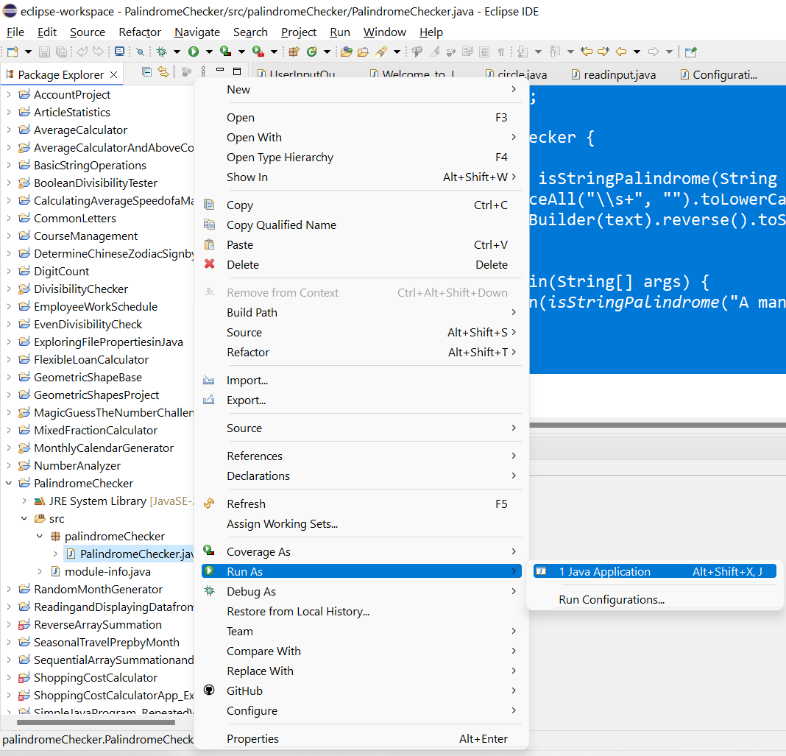
Run the Program:
Save the file and right-click on the class, then select Run As > Java Application. The console will display the result of the palindrome check for the sample input.
22

Slide 23
Step-by-Step Solution in Eclipse for Task in Assessment 2: Palindrome Checker for Integers:
Create a New Project and Class:
Similar to the Task we solved, create a new Java project and a class named IntegerPalindromeChecker.
Implement the reverse and isPalindrome Methods:
Implement the reverse method that converts an integer to a string, reverses it, and converts it back to an integer.
Use the reverse method inside the isPalindrome method to check if a number is a palindrome.
23

Slide 24
The Task we solved deals with checking whether a given string is a palindrome, whereas Task 1 Assessment 2 focuses on checking whether an integer is a palindrome by reversing it.
Both tasks share the common goal of checking for palindromes, but Task 1 Assessment 2 includes integer-specific operations, while the Task we solved works with strings.
24

Slide 25
Discussion Question
How can you determine which day of the week has the maximum total work hours from a given 2D array of work hours?
Iterate through each day of the week, summing up all employee hours for that day, and compare it to the maximum found so far.
25

Slide 26
Discussion Question
What is the advantage of using ArrayList over arrays in Java?
ArrayList provides dynamic sizing while arrays are fixed in size. This makes ArrayList more versatile when the number of elements can change dynamically during runtime.
26

Slide 27
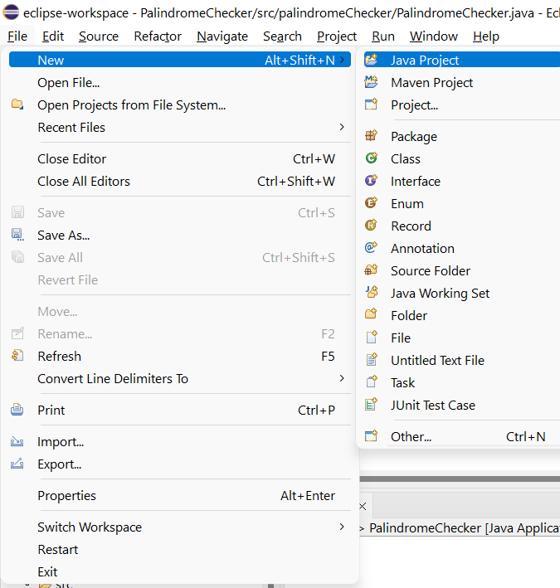
Task: Employee Work Hours Analysis
1. Open Eclipse:
Start Eclipse IDE.
Create a new Java project via File > New > Java Project.
27

Slide 28
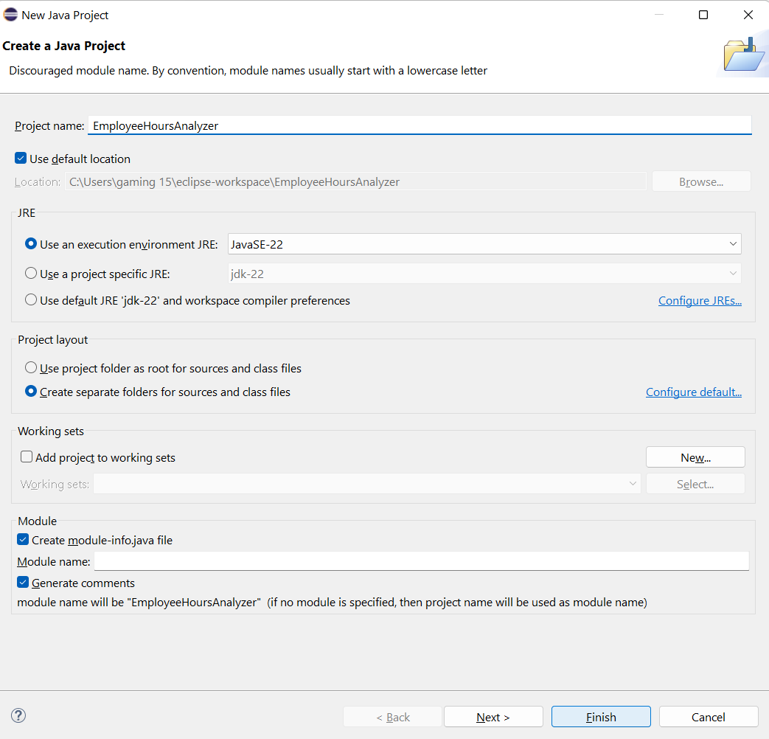
Task: Employee Work Hours Analysis
1. Open Eclipse:
Start Eclipse IDE.
Create a new Java project via File > New > Java Project.
28

Slide 29
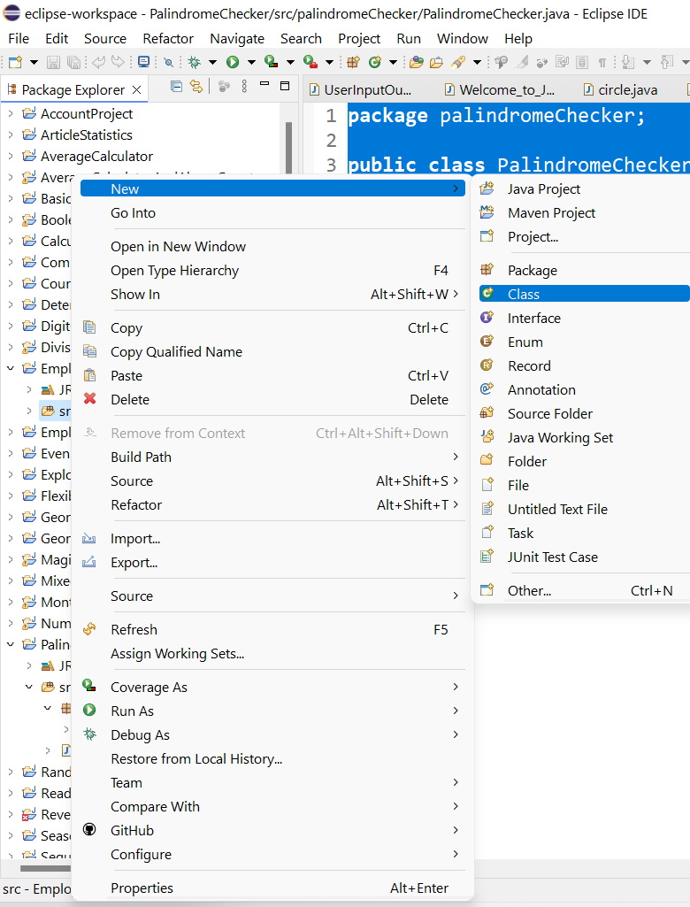
Task: Employee Work Hours Analysis
2. Create a New Class:
In your project, right-click the src folder and choose New > Class.
Name your class EmployeeHoursAnalyzer.
Ensure to select the checkbox to include the public static void main(String[] args) method.
29

Slide 30
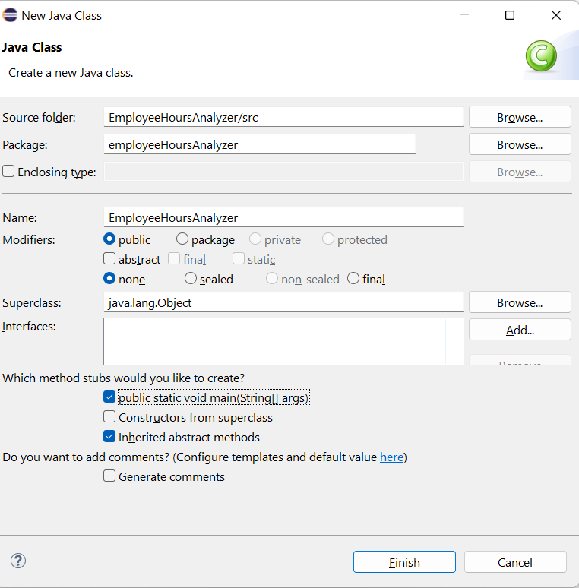
Task: Employee Work Hours Analysis
2. Create a New Class:
In your project, right-click the src folder and choose New > Class.
Name your class EmployeeHoursAnalyzer.
Ensure to select the checkbox to include the public static void main(String[] args) method.
30

Slide 31
package employeeHoursAnalyzer;
public class EmployeeHoursAnalyzer {
public static void findMaxAverageHours(int[][] hours) {
double maxAvg = 0;
int employeeId = -1;
for (int i = 0; i < hours.length; i++) {
double sum = 0;
for (int j = 0; j < hours[i].length; j++) {
sum += hours[i][j];
}
double avg = sum / hours[i].length;
if (avg > maxAvg) {
maxAvg = avg;
employeeId = i;
}
}
System.out.println("Employee " + employeeId + " has the highest average hours: " + maxAvg);
}
public static void main(String[] args) {
int[][] hours = {
{2, 4, 3, 4, 5, 8, 8},
{7, 3, 4, 3, 3, 4, 4},
{3, 3, 4, 3, 3, 2, 2},
{9, 3, 4, 7, 3, 4, 1}
};
findMaxAverageHours(hours);
}
}
3. Implement the Method for Maximum Average Hours:
Inside the class, you will write the method findMaxAverageHours that calculates which employee has the highest average hours per day over a week. You'll also add a main method to test this functionality.
31

Slide 32
package employeeHoursAnalyzer;
public class EmployeeHoursAnalyzer {
public static void findMaxAverageHours(int[][] hours) {
double maxAvg = 0;
int employeeId = -1;
for (int i = 0; i < hours.length; i++) {
double sum = 0;
for (int j = 0; j < hours[i].length; j++) {
sum += hours[i][j];
}
double avg = sum / hours[i].length;
if (avg > maxAvg) {
maxAvg = avg;
employeeId = i;
}
}
System.out.println("Employee " + employeeId + " has the highest average hours: " + maxAvg);
}
public static void main(String[] args) {
int[][] hours = {
{2, 4, 3, 4, 5, 8, 8},
{7, 3, 4, 3, 3, 4, 4},
{3, 3, 4, 3, 3, 2, 2},
{9, 3, 4, 7, 3, 4, 1}
};
findMaxAverageHours(hours);
}
}
1. Package Declaration:
The code is part of the employeeHoursAnalyzer package, used to organize related classes.
2. Class Declaration:
The class EmployeeHoursAnalyzer contains the logic for finding the employee with the highest average working hours.
32

Slide 33
package employeeHoursAnalyzer;
public class EmployeeHoursAnalyzer {
public static void findMaxAverageHours(int[][] hours) {
double maxAvg = 0;
int employeeId = -1;
for (int i = 0; i < hours.length; i++) {
double sum = 0;
for (int j = 0; j < hours[i].length; j++) {
sum += hours[i][j];
}
double avg = sum / hours[i].length;
if (avg > maxAvg) {
maxAvg = avg;
employeeId = i;
}
}
System.out.println("Employee " + employeeId + " has the highest average hours: " + maxAvg);
}
public static void main(String[] args) {
int[][] hours = {
{2, 4, 3, 4, 5, 8, 8},
{7, 3, 4, 3, 3, 4, 4},
{3, 3, 4, 3, 3, 2, 2},
{9, 3, 4, 7, 3, 4, 1}
};
findMaxAverageHours(hours);
}
}
3. findMaxAverageHours Method:
This method takes a 2D array hours, where each row represents an employee, and each column represents their hours worked on different days of the week.
Variables:
maxAvg (double): Stores the highest average hours found so far.
employeeId (int): Stores the index (or ID) of the employee with the highest average hours.
33

Slide 34
package employeeHoursAnalyzer;
public class EmployeeHoursAnalyzer {
public static void findMaxAverageHours(int[][] hours) {
double maxAvg = 0;
int employeeId = -1;
for (int i = 0; i < hours.length; i++) {
double sum = 0;
for (int j = 0; j < hours[i].length; j++) {
sum += hours[i][j];
}
double avg = sum / hours[i].length;
if (avg > maxAvg) {
maxAvg = avg;
employeeId = i;
}
}
System.out.println("Employee " + employeeId + " has the highest average hours: " + maxAvg);
}
public static void main(String[] args) {
int[][] hours = {
{2, 4, 3, 4, 5, 8, 8},
{7, 3, 4, 3, 3, 4, 4},
{3, 3, 4, 3, 3, 2, 2},
{9, 3, 4, 7, 3, 4, 1}
};
findMaxAverageHours(hours);
}
}
Outer Loop:Loops through each employee (i.e., each row of the 2D array).
For each employee, it calculates the total hours worked in the week by summing the values in their respective row.
34

Slide 35
package employeeHoursAnalyzer;
public class EmployeeHoursAnalyzer {
public static void findMaxAverageHours(int[][] hours) {
double maxAvg = 0;
int employeeId = -1;
for (int i = 0; i < hours.length; i++) {
double sum = 0;
for (int j = 0; j < hours[i].length; j++) {
sum += hours[i][j];
}
double avg = sum / hours[i].length;
if (avg > maxAvg) {
maxAvg = avg;
employeeId = i;
}
}
System.out.println("Employee " + employeeId + " has the highest average hours: " + maxAvg);
}
public static void main(String[] args) {
int[][] hours = {
{2, 4, 3, 4, 5, 8, 8},
{7, 3, 4, 3, 3, 4, 4},
{3, 3, 4, 3, 3, 2, 2},
{9, 3, 4, 7, 3, 4, 1}
};
findMaxAverageHours(hours);
}
}
Inner Loop:
Loops through the hours worked by an employee each day (i.e., each column of the row).
Adds up the hours to get the total hours for the week for that employee.
35

Slide 36
package employeeHoursAnalyzer;
public class EmployeeHoursAnalyzer {
public static void findMaxAverageHours(int[][] hours) {
double maxAvg = 0;
int employeeId = -1;
for (int i = 0; i < hours.length; i++) {
double sum = 0;
for (int j = 0; j < hours[i].length; j++) {
sum += hours[i][j];
}
double avg = sum / hours[i].length;
if (avg > maxAvg) {
maxAvg = avg;
employeeId = i;
}
}
System.out.println("Employee " + employeeId + " has the highest average hours: " + maxAvg);
}
public static void main(String[] args) {
int[][] hours = {
{2, 4, 3, 4, 5, 8, 8},
{7, 3, 4, 3, 3, 4, 4},
{3, 3, 4, 3, 3, 2, 2},
{9, 3, 4, 7, 3, 4, 1}
};
findMaxAverageHours(hours);
}
}
Average Calculation:After summing the weekly hours, it calculates the average by dividing the total hours by the number of days (the length of the row).
36

Slide 37
package employeeHoursAnalyzer;
public class EmployeeHoursAnalyzer {
public static void findMaxAverageHours(int[][] hours) {
double maxAvg = 0;
int employeeId = -1;
for (int i = 0; i < hours.length; i++) {
double sum = 0;
for (int j = 0; j < hours[i].length; j++) {
sum += hours[i][j];
}
double avg = sum / hours[i].length;
if (avg > maxAvg) {
maxAvg = avg;
employeeId = i;
}
}
System.out.println("Employee " + employeeId + " has the highest average hours: " + maxAvg);
}
public static void main(String[] args) {
int[][] hours = {
{2, 4, 3, 4, 5, 8, 8},
{7, 3, 4, 3, 3, 4, 4},
{3, 3, 4, 3, 3, 2, 2},
{9, 3, 4, 7, 3, 4, 1}
};
findMaxAverageHours(hours);
}
}
Comparison:
If the calculated average for the current employee is higher than the current maxAvg, it updates maxAvg and assigns the current employee’s ID (i).
37

Slide 38
package employeeHoursAnalyzer;
public class EmployeeHoursAnalyzer {
public static void findMaxAverageHours(int[][] hours) {
double maxAvg = 0;
int employeeId = -1;
for (int i = 0; i < hours.length; i++) {
double sum = 0;
for (int j = 0; j < hours[i].length; j++) {
sum += hours[i][j];
}
double avg = sum / hours[i].length;
if (avg > maxAvg) {
maxAvg = avg;
employeeId = i;
}
}
System.out.println("Employee " + employeeId + " has the highest average hours: " + maxAvg);
}
public static void main(String[] args) {
int[][] hours = {
{2, 4, 3, 4, 5, 8, 8},
{7, 3, 4, 3, 3, 4, 4},
{3, 3, 4, 3, 3, 2, 2},
{9, 3, 4, 7, 3, 4, 1}
};
findMaxAverageHours(hours);
}
}
Output:After the loop completes, it prints out the employee ID and their highest average hours.
38

Slide 39
package employeeHoursAnalyzer;
public class EmployeeHoursAnalyzer {
public static void findMaxAverageHours(int[][] hours) {
double maxAvg = 0;
int employeeId = -1;
for (int i = 0; i < hours.length; i++) {
double sum = 0;
for (int j = 0; j < hours[i].length; j++) {
sum += hours[i][j];
}
double avg = sum / hours[i].length;
if (avg > maxAvg) {
maxAvg = avg;
employeeId = i;
}
}
System.out.println("Employee " + employeeId + " has the highest average hours: " + maxAvg);
}
public static void main(String[] args) {
int[][] hours = {
{2, 4, 3, 4, 5, 8, 8},
{7, 3, 4, 3, 3, 4, 4},
{3, 3, 4, 3, 3, 2, 2},
{9, 3, 4, 7, 3, 4, 1}
};
findMaxAverageHours(hours);
}
}
Main Method:
The main method initializes a 2D array hours, where:
Each row represents an employee’s weekly working hours.
For example, the first employee worked {2, 4, 3, 4, 5, 8, 8} hours on seven days of the week.
It calls the findMaxAverageHours method with this hours array, which processes the data and prints the result.
39

Slide 40
package employeeHoursAnalyzer;
public class EmployeeHoursAnalyzer {
public static void findMaxAverageHours(int[][] hours) {
double maxAvg = 0;
int employeeId = -1;
for (int i = 0; i < hours.length; i++) {
double sum = 0;
for (int j = 0; j < hours[i].length; j++) {
sum += hours[i][j];
}
double avg = sum / hours[i].length;
if (avg > maxAvg) {
maxAvg = avg;
employeeId = i;
}
}
System.out.println("Employee " + employeeId + " has the highest average hours: " + maxAvg);
}
public static void main(String[] args) {
int[][] hours = {
{2, 4, 3, 4, 5, 8, 8},
{7, 3, 4, 3, 3, 4, 4},
{3, 3, 4, 3, 3, 2, 2},
{9, 3, 4, 7, 3, 4, 1}
};
findMaxAverageHours(hours);
}
}
We can see input hours array
The method computes the average for each employee:
Employee 0: (2 + 4 + 3 + 4 + 5 + 8 + 8) / 7 = 4.86
Employee 1: (7 + 3 + 4 + 3 + 3 + 4 + 4) / 7 = 4.00
Employee 2: (3 + 3 + 4 + 3 + 3 + 2 + 2) / 7 = 2.86
Employee 3: (9 + 3 + 4 + 7 + 3 + 4 + 1) / 7 = 4.43
The employee with the highest average hours is Employee 0 with an average of 4.86 hours.
40

Slide 41
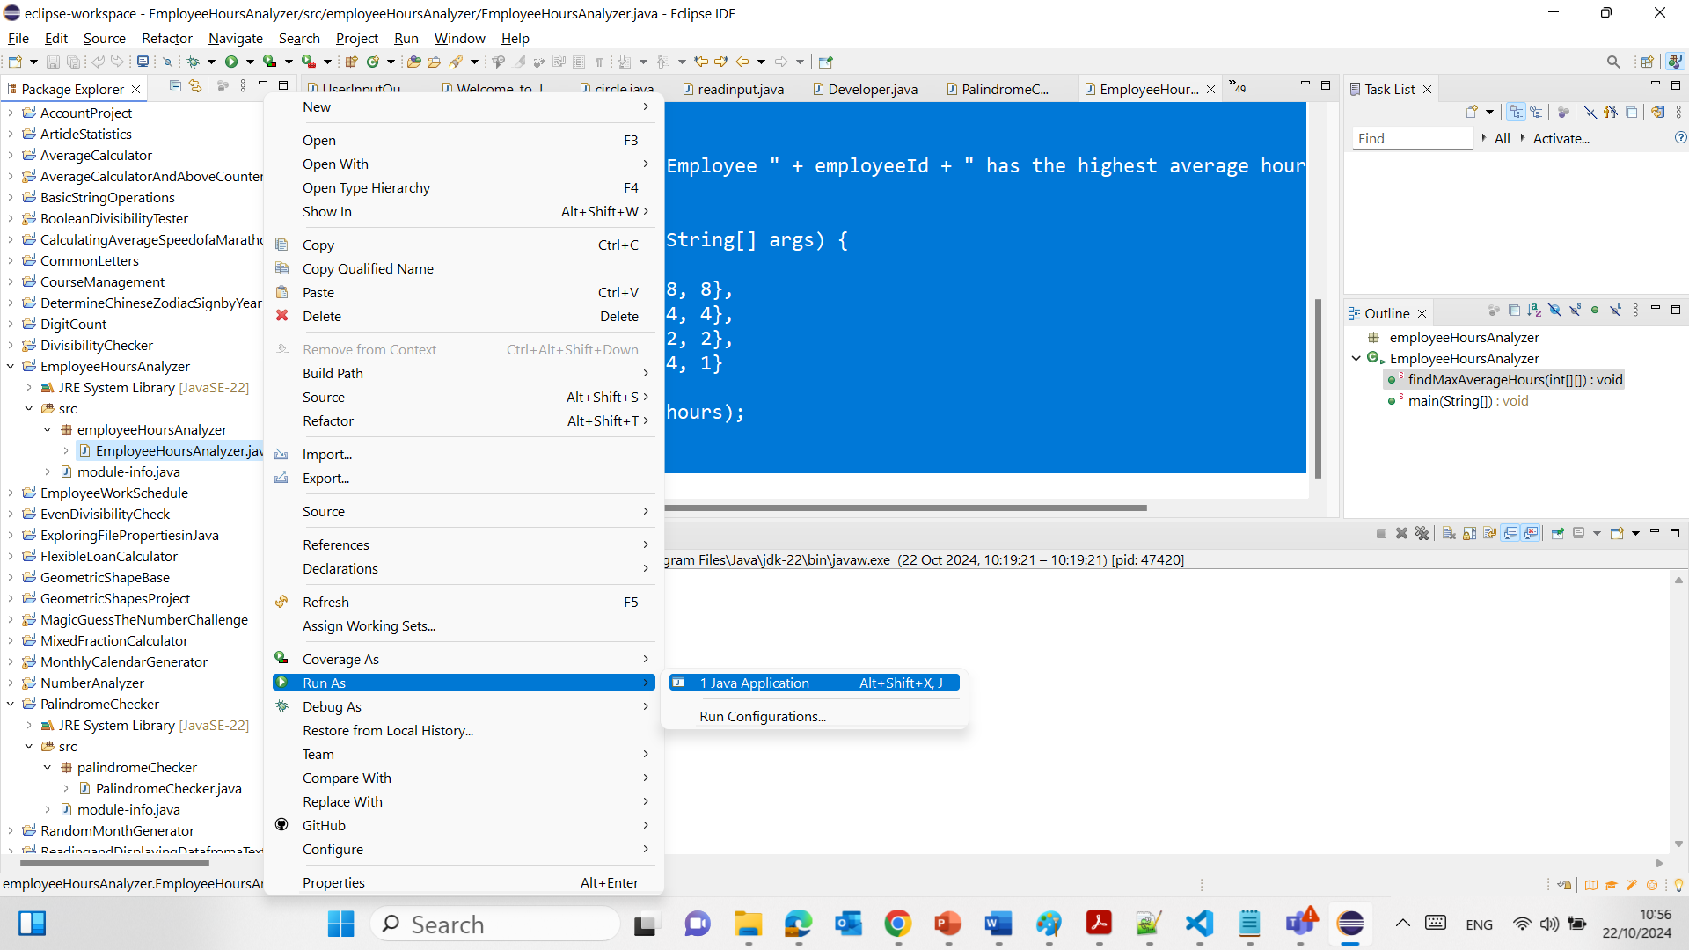
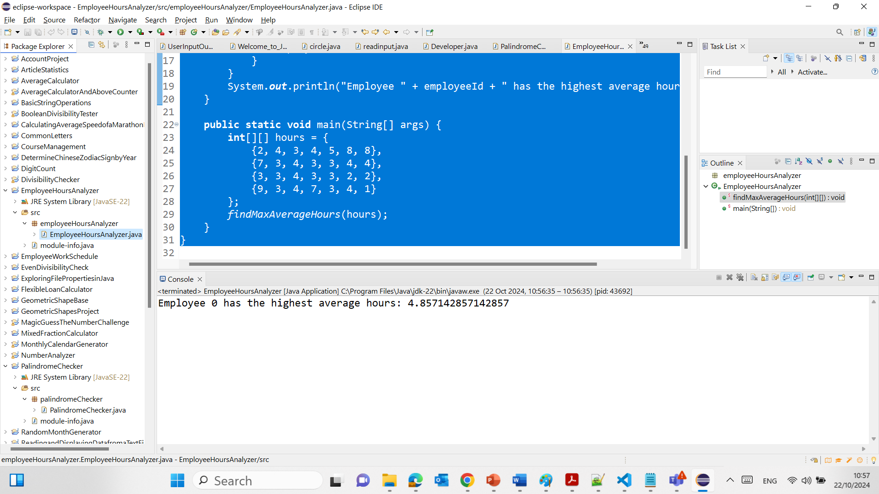
Run the Program:
Save your Java file and run it by right-clicking on the file and selecting Run As > Java Application. The output will display the employee ID with the highest average daily hours.
41

Slide 42
Task: Employee Work Hours Analysis requires you to calculate and display the employee with the highest average daily hours over a week using a 2D array.
Star Employees and Busiest Days Task in Assessment 2, on the other hand, asks for finding the employee who worked the most total hours in a week (star employee) and the busiest day(s) based on total hours worked by all employees.
Star Employees and Busiest Days Task in Assessment 2 involves additional calculations for both the total hours per employee and per day, potentially identifying multiple "star" employees and "busiest" days, unlike Task Employee Work Hours Analysis, which solely focuses on the average per day per employee.
42

Slide 43
True/False Statements
The reverse() method in Java is used to reverse the contents of lists and not strings.
True (Strings need to be converted to StringBuilder or StringBuffer to use the reverse() method).
43

Slide 44
True/False Statements
Encapsulation in Java is strictly enforced by making all member variables public.
False (Encapsulation is enforced by making members private and providing public getters and setters).
44

Slide 45
Task: Simple Age Processor
Sample Assignment:
Task: Create a Java program to process a list of ages and display statistics.
Requirements:
Methods to calculate the maximum, minimum, and average ages.
Display the sorted list of ages.
45

Slide 46
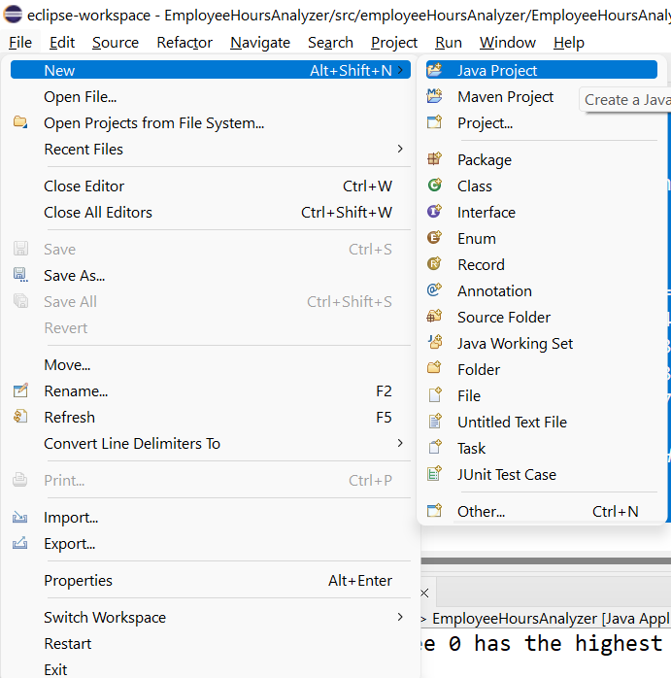
Task: Simple Age Processor
1. Open Eclipse:
Launch the Eclipse IDE.
Create a new Java project by navigating to File > New > Java Project.
46

Slide 47
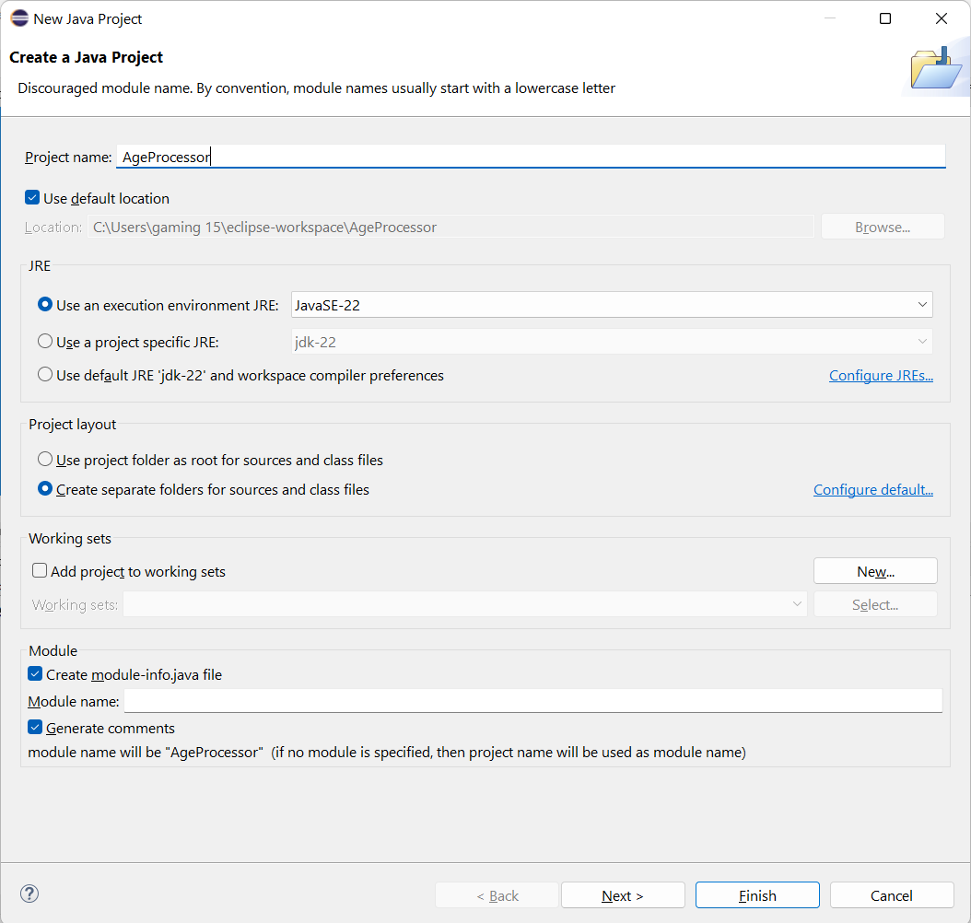
Task: Simple Age Processor
1. Open Eclipse:
Launch the Eclipse IDE.
Create a new Java project by navigating to File > New > Java Project.
47

Slide 48
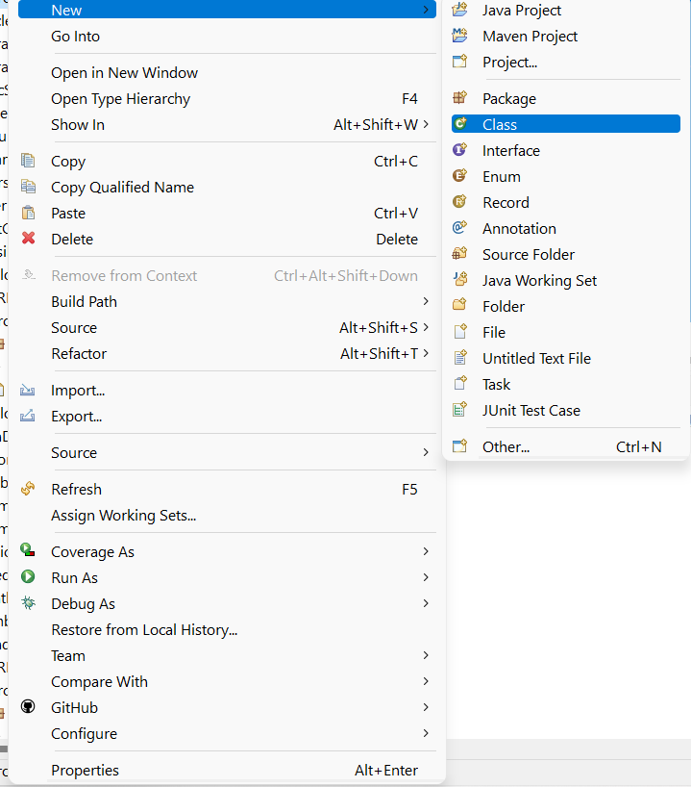
Task: Simple Age Processor
2. Create a New Class:
In your project, right-click on the src folder and select New > Class.
Name the class AgeProcessor.
Ensure to select the checkbox to create the public static void main(String[] args) method.
48

Slide 49
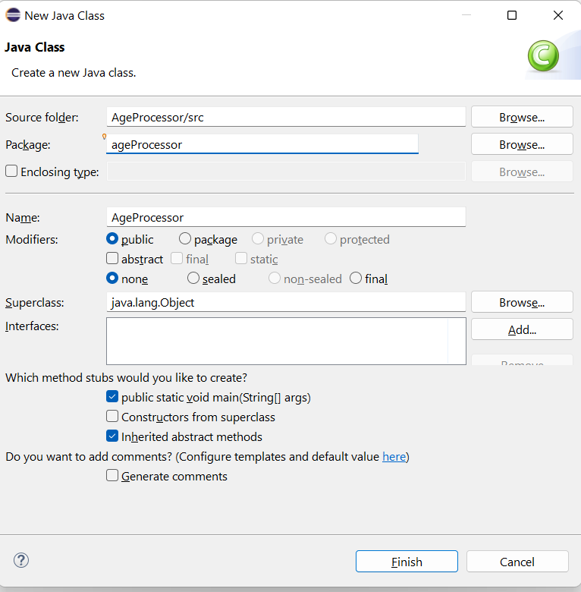
Task: Simple Age Processor
2. Create a New Class:
In your project, right-click on the src folder and select New > Class.
Name the class AgeProcessor.
Ensure to select the checkbox to create the public static void main(String[] args) method.
49

Slide 50
Task: Simple Age Processor
3. Implement Age Processing Methods:
Inside the class, implement the methods to handle age data: getting ages, finding maximum, minimum, and average ages, and displaying them sorted.
50

Slide 51
Task: Simple Age Processor
The code processes a list of ages by calculating and displaying various statistics, such as the maximum, minimum, and average age, and it also sorts the list before displaying it.
package ageProcessor;
import java.util.ArrayList;
import java.util.Collections;
public class AgeProcessor {
public static ArrayList<Integer> getAges() {
ArrayList<Integer> ages = new ArrayList<>();
ages.add(23);
ages.add(45);
ages.add(30); // Example ages
return ages;
}
public static int getMaxAge(ArrayList<Integer> ages) {
return Collections.max(ages);
}
public static int getMinAge(ArrayList<Integer> ages) {
return Collections.min(ages);
}
public static double getAvgAge(ArrayList<Integer> ages) {
return ages.stream().mapToInt(Integer::intValue).average().orElse(0.0);
}
public static void displayAges(ArrayList<Integer> ages) {
Collections.sort(ages);
System.out.println("Sorted Ages: " + ages);
System.out.println("Max Age: " + getMaxAge(ages) + ", Min Age: " + getMinAge(ages) +
", Average Age: " + getAvgAge(ages));
}
public static void main(String[] args) {
ArrayList<Integer> ages = getAges();
displayAges(ages);
}
}
51

Slide 52
Task: Simple Age Processor
Package Declaration:
The code belongs to the package ageProcessor, which helps organize the class logically.
package ageProcessor;
import java.util.ArrayList;
import java.util.Collections;
public class AgeProcessor {
public static ArrayList<Integer> getAges() {
ArrayList<Integer> ages = new ArrayList<>();
ages.add(23);
ages.add(45);
ages.add(30); // Example ages
return ages;
}
public static int getMaxAge(ArrayList<Integer> ages) {
return Collections.max(ages);
}
public static int getMinAge(ArrayList<Integer> ages) {
return Collections.min(ages);
}
public static double getAvgAge(ArrayList<Integer> ages) {
return ages.stream().mapToInt(Integer::intValue).average().orElse(0.0);
}
public static void displayAges(ArrayList<Integer> ages) {
Collections.sort(ages);
System.out.println("Sorted Ages: " + ages);
System.out.println("Max Age: " + getMaxAge(ages) + ", Min Age: " + getMinAge(ages) +
", Average Age: " + getAvgAge(ages));
}
public static void main(String[] args) {
ArrayList<Integer> ages = getAges();
displayAges(ages);
}
}
52

Slide 53
Task: Simple Age Processor
Imports:
The code imports two classes:
ArrayList: This is used to store a list of integers (ages).
Collections: This class provides utility methods for operating on collections like sorting, finding max/min values, etc.
package ageProcessor;
import java.util.ArrayList;
import java.util.Collections;
public class AgeProcessor {
public static ArrayList<Integer> getAges() {
ArrayList<Integer> ages = new ArrayList<>();
ages.add(23);
ages.add(45);
ages.add(30); // Example ages
return ages;
}
public static int getMaxAge(ArrayList<Integer> ages) {
return Collections.max(ages);
}
public static int getMinAge(ArrayList<Integer> ages) {
return Collections.min(ages);
}
public static double getAvgAge(ArrayList<Integer> ages) {
return ages.stream().mapToInt(Integer::intValue).average().orElse(0.0);
}
public static void displayAges(ArrayList<Integer> ages) {
Collections.sort(ages);
System.out.println("Sorted Ages: " + ages);
System.out.println("Max Age: " + getMaxAge(ages) + ", Min Age: " + getMinAge(ages) +
", Average Age: " + getAvgAge(ages));
}
public static void main(String[] args) {
ArrayList<Integer> ages = getAges();
displayAges(ages);
}
}
53

Slide 54
Task: Simple Age Processor
Class Declaration:
The AgeProcessor class contains methods for handling age data.
package ageProcessor;
import java.util.ArrayList;
import java.util.Collections;
public class AgeProcessor {
public static ArrayList<Integer> getAges() {
ArrayList<Integer> ages = new ArrayList<>();
ages.add(23);
ages.add(45);
ages.add(30); // Example ages
return ages;
}
public static int getMaxAge(ArrayList<Integer> ages) {
return Collections.max(ages);
}
public static int getMinAge(ArrayList<Integer> ages) {
return Collections.min(ages);
}
public static double getAvgAge(ArrayList<Integer> ages) {
return ages.stream().mapToInt(Integer::intValue).average().orElse(0.0);
}
public static void displayAges(ArrayList<Integer> ages) {
Collections.sort(ages);
System.out.println("Sorted Ages: " + ages);
System.out.println("Max Age: " + getMaxAge(ages) + ", Min Age: " + getMinAge(ages) +
", Average Age: " + getAvgAge(ages));
}
public static void main(String[] args) {
ArrayList<Integer> ages = getAges();
displayAges(ages);
}
}
54

Slide 55
Task: Simple Age Processor
Method: getAges()
This method creates an ArrayList<Integer> that holds a set of ages (23, 45, and 30).
It returns this list of ages to be processed further.
Example Output: [23, 45, 30]
package ageProcessor;
import java.util.ArrayList;
import java.util.Collections;
public class AgeProcessor {
public static ArrayList<Integer> getAges() {
ArrayList<Integer> ages = new ArrayList<>();
ages.add(23);
ages.add(45);
ages.add(30); // Example ages
return ages;
}
public static int getMaxAge(ArrayList<Integer> ages) {
return Collections.max(ages);
}
public static int getMinAge(ArrayList<Integer> ages) {
return Collections.min(ages);
}
public static double getAvgAge(ArrayList<Integer> ages) {
return ages.stream().mapToInt(Integer::intValue).average().orElse(0.0);
}
public static void displayAges(ArrayList<Integer> ages) {
Collections.sort(ages);
System.out.println("Sorted Ages: " + ages);
System.out.println("Max Age: " + getMaxAge(ages) + ", Min Age: " + getMinAge(ages) +
", Average Age: " + getAvgAge(ages));
}
public static void main(String[] args) {
ArrayList<Integer> ages = getAges();
displayAges(ages);
}
}
55

Slide 56
Task: Simple Age Processor
Method: getMaxAge(ArrayList<Integer> ages)
This method takes the list of ages as input and uses Collections.max() to return the maximum age in the list.
Example Output: 45 (for the example list [23, 45, 30])
package ageProcessor;
import java.util.ArrayList;
import java.util.Collections;
public class AgeProcessor {
public static ArrayList<Integer> getAges() {
ArrayList<Integer> ages = new ArrayList<>();
ages.add(23);
ages.add(45);
ages.add(30); // Example ages
return ages;
}
public static int getMaxAge(ArrayList<Integer> ages) {
return Collections.max(ages);
}
public static int getMinAge(ArrayList<Integer> ages) {
return Collections.min(ages);
}
public static double getAvgAge(ArrayList<Integer> ages) {
return ages.stream().mapToInt(Integer::intValue).average().orElse(0.0);
}
public static void displayAges(ArrayList<Integer> ages) {
Collections.sort(ages);
System.out.println("Sorted Ages: " + ages);
System.out.println("Max Age: " + getMaxAge(ages) + ", Min Age: " + getMinAge(ages) +
", Average Age: " + getAvgAge(ages));
}
public static void main(String[] args) {
ArrayList<Integer> ages = getAges();
displayAges(ages);
}
}
56

Slide 57
Task: Simple Age Processor
Method: getMinAge(ArrayList<Integer> ages)
This method takes the list of ages and uses Collections.min() to return the minimum age in the list.
Example Output: 23 (for the example list [23, 45, 30])
package ageProcessor;
import java.util.ArrayList;
import java.util.Collections;
public class AgeProcessor {
public static ArrayList<Integer> getAges() {
ArrayList<Integer> ages = new ArrayList<>();
ages.add(23);
ages.add(45);
ages.add(30); // Example ages
return ages;
}
public static int getMaxAge(ArrayList<Integer> ages) {
return Collections.max(ages);
}
public static int getMinAge(ArrayList<Integer> ages) {
return Collections.min(ages);
}
public static double getAvgAge(ArrayList<Integer> ages) {
return ages.stream().mapToInt(Integer::intValue).average().orElse(0.0);
}
public static void displayAges(ArrayList<Integer> ages) {
Collections.sort(ages);
System.out.println("Sorted Ages: " + ages);
System.out.println("Max Age: " + getMaxAge(ages) + ", Min Age: " + getMinAge(ages) +
", Average Age: " + getAvgAge(ages));
}
public static void main(String[] args) {
ArrayList<Integer> ages = getAges();
displayAges(ages);
}
}
57

Slide 58
Task: Simple Age Processor
Method: getAvgAge(ArrayList<Integer> ages)
This method calculates the average age in the list by converting the ages to an integer stream, summing the values, and dividing by the count.
It uses the stream().mapToInt(Integer::intValue).average() method and returns the average age.
Example Output: 32.67 (for the example list [23, 45, 30])
package ageProcessor;
import java.util.ArrayList;
import java.util.Collections;
public class AgeProcessor {
public static ArrayList<Integer> getAges() {
ArrayList<Integer> ages = new ArrayList<>();
ages.add(23);
ages.add(45);
ages.add(30); // Example ages
return ages;
}
public static int getMaxAge(ArrayList<Integer> ages) {
return Collections.max(ages);
}
public static int getMinAge(ArrayList<Integer> ages) {
return Collections.min(ages);
}
public static double getAvgAge(ArrayList<Integer> ages) {
return ages.stream().mapToInt(Integer::intValue).average().orElse(0.0);
}
public static void displayAges(ArrayList<Integer> ages) {
Collections.sort(ages);
System.out.println("Sorted Ages: " + ages);
System.out.println("Max Age: " + getMaxAge(ages) + ", Min Age: " + getMinAge(ages) +
", Average Age: " + getAvgAge(ages));
}
public static void main(String[] args) {
ArrayList<Integer> ages = getAges();
displayAges(ages);
}
}
58

Slide 59
Task: Simple Age Processor
package ageProcessor;
import java.util.ArrayList;
import java.util.Collections;
public class AgeProcessor {
public static ArrayList<Integer> getAges() {
ArrayList<Integer> ages = new ArrayList<>();
ages.add(23);
ages.add(45);
ages.add(30); // Example ages
return ages;
}
public static int getMaxAge(ArrayList<Integer> ages) {
return Collections.max(ages);
}
public static int getMinAge(ArrayList<Integer> ages) {
return Collections.min(ages);
}
public static double getAvgAge(ArrayList<Integer> ages) {
return ages.stream().mapToInt(Integer::intValue).average().orElse(0.0);
}
public static void displayAges(ArrayList<Integer> ages) {
Collections.sort(ages);
System.out.println("Sorted Ages: " + ages);
System.out.println("Max Age: " + getMaxAge(ages) + ", Min Age: " + getMinAge(ages) +
", Average Age: " + getAvgAge(ages));
}
public static void main(String[] args) {
ArrayList<Integer> ages = getAges();
displayAges(ages);
}
}
Method: displayAges(ArrayList<Integer> ages)
This method first sorts the list of ages using Collections.sort(ages) and then prints the sorted ages.
It also calls the previously defined methods to calculate and print the maximum age, minimum age, and average age.
Example Output:
Sorted ages: [23, 30, 45]
Maximum age: 45
Minimum age: 23
Average age: 32.67
59

Slide 60
Task: Simple Age Processor
Main Method:
The main method serves as the entry point of the program. It:
Calls getAges() to retrieve the list of ages.
Passes this list to displayAges(), which processes and displays the sorted list along with age statistics.
package ageProcessor;
import java.util.ArrayList;
import java.util.Collections;
public class AgeProcessor {
public static ArrayList<Integer> getAges() {
ArrayList<Integer> ages = new ArrayList<>();
ages.add(23);
ages.add(45);
ages.add(30); // Example ages
return ages;
}
public static int getMaxAge(ArrayList<Integer> ages) {
return Collections.max(ages);
}
public static int getMinAge(ArrayList<Integer> ages) {
return Collections.min(ages);
}
public static double getAvgAge(ArrayList<Integer> ages) {
return ages.stream().mapToInt(Integer::intValue).average().orElse(0.0);
}
public static void displayAges(ArrayList<Integer> ages) {
Collections.sort(ages);
System.out.println("Sorted Ages: " + ages);
System.out.println("Max Age: " + getMaxAge(ages) + ", Min Age: " + getMinAge(ages) +
", Average Age: " + getAvgAge(ages));
}
public static void main(String[] args) {
ArrayList<Integer> ages = getAges();
displayAges(ages);
}
}
60

Slide 61
Task: Simple Age Processor
Example of Program Execution:
The getAges() method returns the list [23, 45, 30].
The displayAges() method sorts the list into [23, 30, 45].
It then calculates:
Maximum age: 45
Minimum age: 23
Average age: 32.67
package ageProcessor;
import java.util.ArrayList;
import java.util.Collections;
public class AgeProcessor {
public static ArrayList<Integer> getAges() {
ArrayList<Integer> ages = new ArrayList<>();
ages.add(23);
ages.add(45);
ages.add(30); // Example ages
return ages;
}
public static int getMaxAge(ArrayList<Integer> ages) {
return Collections.max(ages);
}
public static int getMinAge(ArrayList<Integer> ages) {
return Collections.min(ages);
}
public static double getAvgAge(ArrayList<Integer> ages) {
return ages.stream().mapToInt(Integer::intValue).average().orElse(0.0);
}
public static void displayAges(ArrayList<Integer> ages) {
Collections.sort(ages);
System.out.println("Sorted Ages: " + ages);
System.out.println("Max Age: " + getMaxAge(ages) + ", Min Age: " + getMinAge(ages) +
", Average Age: " + getAvgAge(ages));
}
public static void main(String[] args) {
ArrayList<Integer> ages = getAges();
displayAges(ages);
}
}
61

Slide 62
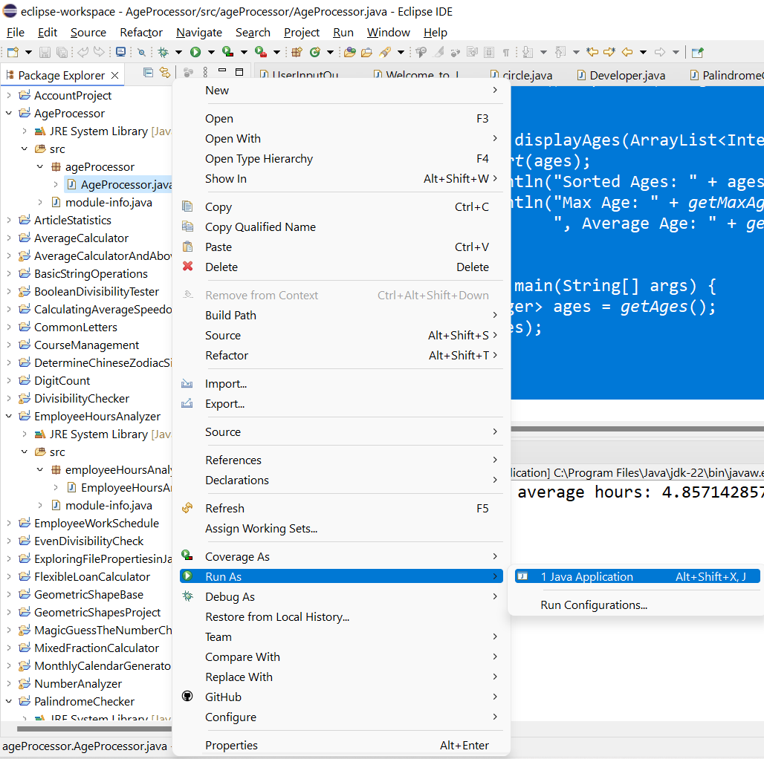
Run the Program:
Save your file and run the class by right-clicking on it and selecting Run As > Java Application. The output will display the sorted list of ages, as well as the maximum, minimum, and average ages.
62

Slide 63
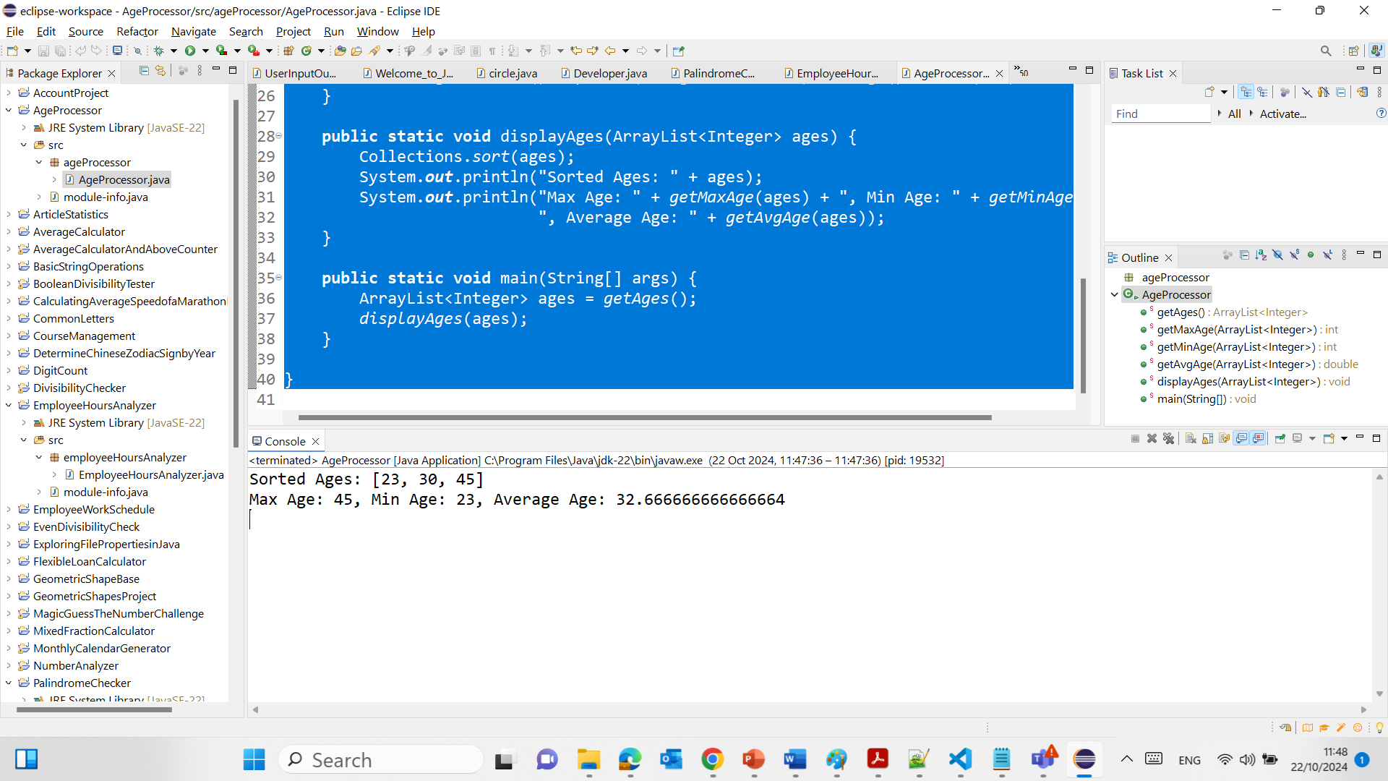
Summary:
The code retrieves a list of ages, sorts it, and prints the sorted list.
It calculates and displays the maximum, minimum, and average age.
63

Slide 64
Task: Simple Age Processor focuses on processing a list of ages and calculating statistical data such as maximum, minimum, and average ages, along with displaying a sorted list of ages.
Task Names and Ages Display in Assessment 2, from the initial understanding, seems to involve processing names and ages together but includes additional tasks such as answering questions and programming modifications based on an existing code base that also processes names, not just ages.
64

Slide 65
Task Names and Ages Display in Assessment 2 requires a more complex approach due to the additional features and tasks involved, whereas Task Simple Age Processor is more straightforward with a focus solely on numerical age data processing.
65

Slide 66
These examples and questions should help guide you on how to approach your assignment 2 and develop solutions that meet high academic standards.
66

Slide 67
Happy a Learning Day!
Dr. Farshid Keivanian

